Slide 1
Report: Implementation of Task Management Tool
Abhilash Sachin Kulkarni • 26.04.2017

Slide 2
Overview
STAGES OF PROJECT
ABOUT TRELLO
TEAMS
BOARDS
LISTS
CARDS
DOCUMENTS
MOBILE APPLICATION
TEST RUN

Slide 3
STAGES OF PROJECT

Slide 4
Comparative study of task management tools and user requirements
Deployment
Testing and Closure
1ST STAGE
2ND STAGE
3RD STAGE
4TH STAGE
5TH STAGE
Customization, Hosting and Mobile Application
User Review and Final Customization

Slide 5
ABOUT TRELLO

Slide 6
A Trello board is a list of lists, filled with cards, which can be used by amy team. It’s a lot more than that, though. Trello has everything needed to organize projects of any size.
Open a card and you can add comments, upload file attachments, create checklists, add labels and due dates, and more.
With checklists and due dates, you won’t miss important tasks, upcoming dates, or items. And with the Calendar Power-Up, everything is in a nice calendar view inside Trello. Or use the iCal feed in your own calendar app
Your data is private and secure. You have full control over who sees your boards. All data is sent over a secure, SSL/HTTPS connection, the same encryption technology used by banks. We keep encrypted, off-site backups of your data in case of disasters.
You can create as many boards, cards, and teams as you like and add as many people as you want. You can choose to make any number of boards or teams private or public.

Slide 7
Teams correspond to the Company

Slide 8
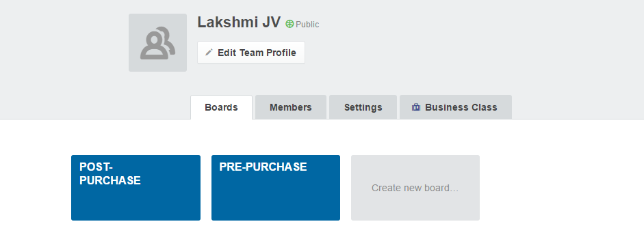
Teams correspond to Company

Slide 9
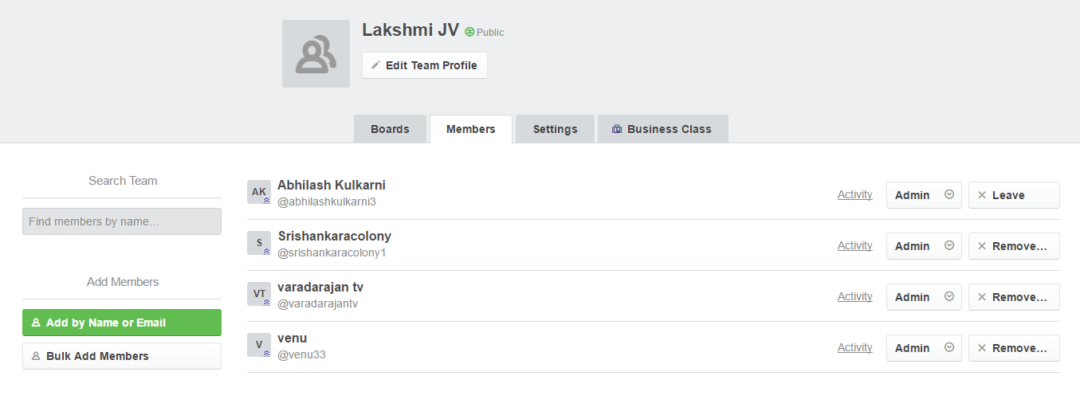
Teams correspond to Company

Slide 10
Boards correspond to Departments

Slide 11
Two Departments
PRE-PURCHASE DEPARTMENT
POST-PURCHASE DEPARTMENT

Slide 12
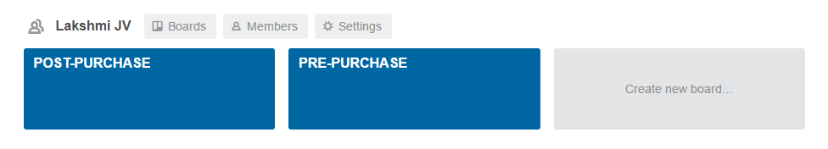
Boards correspond to Departments

Slide 13
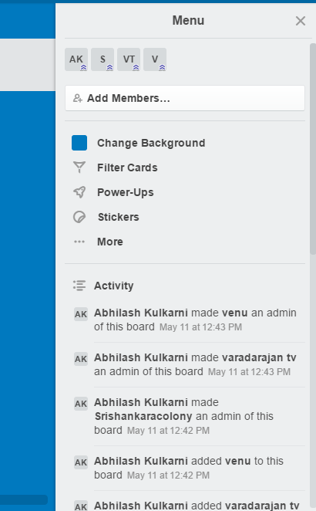
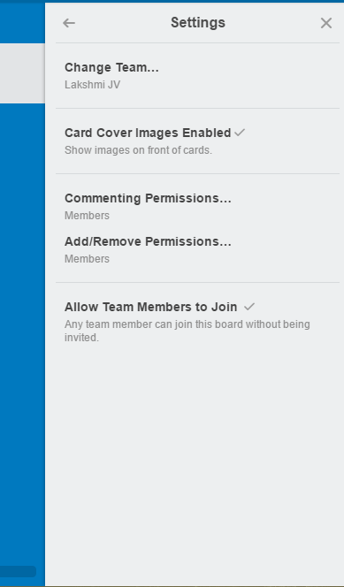
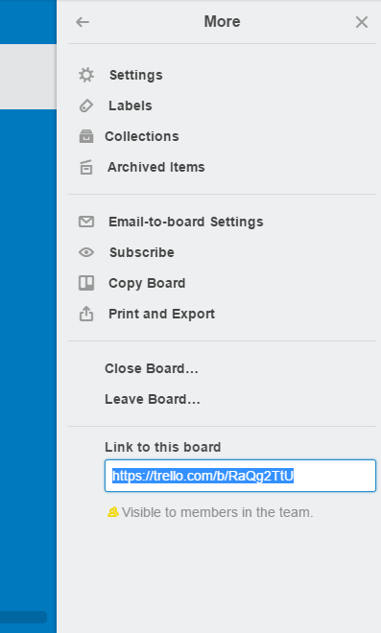
Boards correspond to Departments

Slide 14
Lists correspond to Stages

Slide 15
Stages in the Departments
PRE-PURCHASE DEPARTMENT
PURCHASE ENQUIRY
TO BE PURCHASED
PURCHASE
MASTER CODING
FILING
POST-PURCHASE DEPARTMENT
LAND CONVERSION
GOVERNMENT PERMISSIONS
LAND SUB-DIVISIONS
MAPPING
SITE MARKING
DEVELOPMENT PROCESS

Slide 16
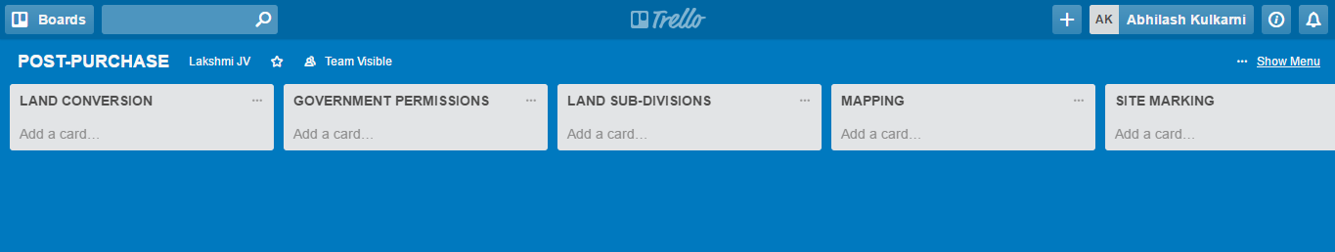
Lists correspond to Stages

Slide 17
Cards correspond to Projects

Slide 18
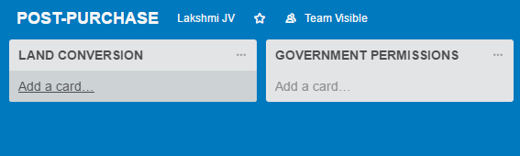
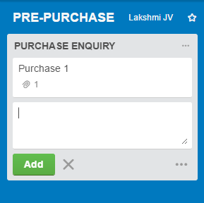
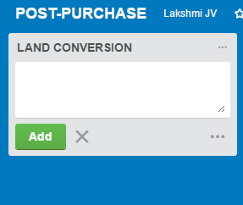
Cards correspond to Projects

Slide 19
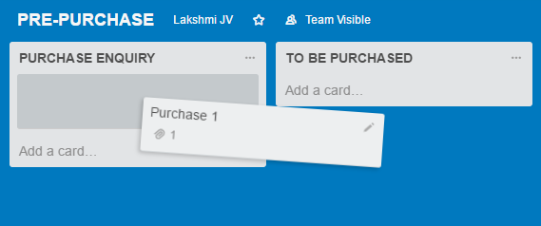
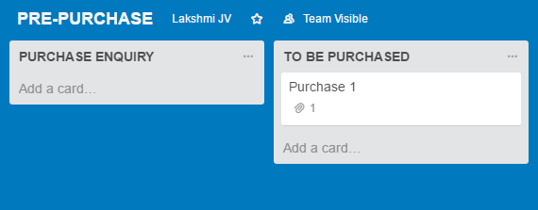
Cards correspond to Projects

Slide 20
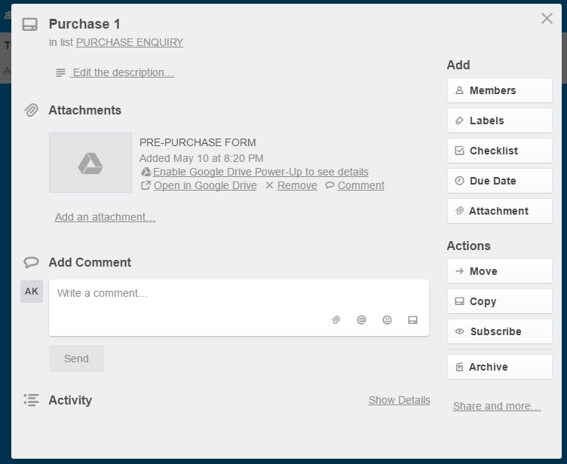
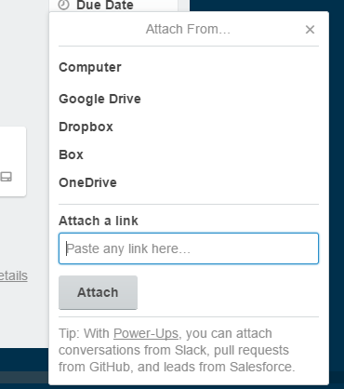
Cards correspond to Projects

Slide 21
Features of a Project card
Title : Project Name
Description : Description of the project
Members : Person assigned to the task
Checklist : Sub-tasks
Due-date : Due-date of the project
Attachment : Forms and documents attached
Label : Sub-stages
Comment : Conversations about the project
Move : Movement from stage-stage or department-department

Slide 22
Documents

Slide 23
Documents are made using Google Sheets
Purchase Enquiry
Application for sales
Property details
Land Jurisdictions
Payment structure
References
Ready Infrastructure
Attachment Required
Payment Details
Mode of payment
Each Google sheet is for one project and it contains 10 forms.

Slide 24
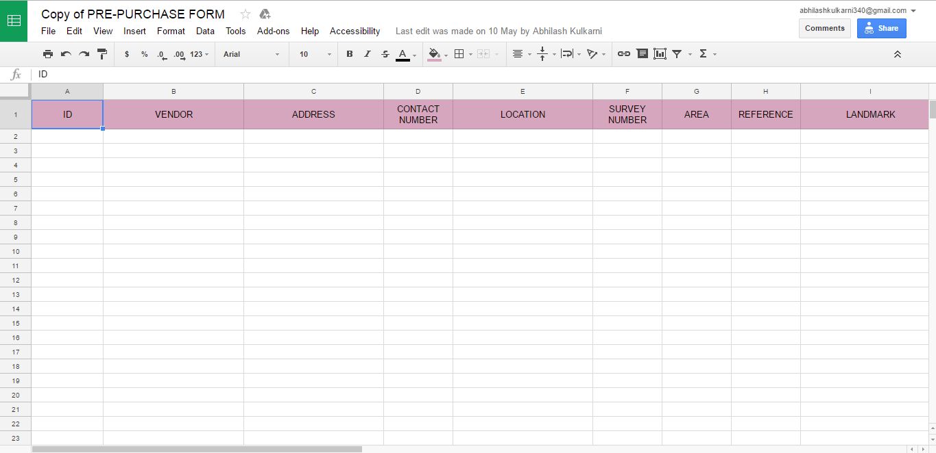
Documents

Slide 25
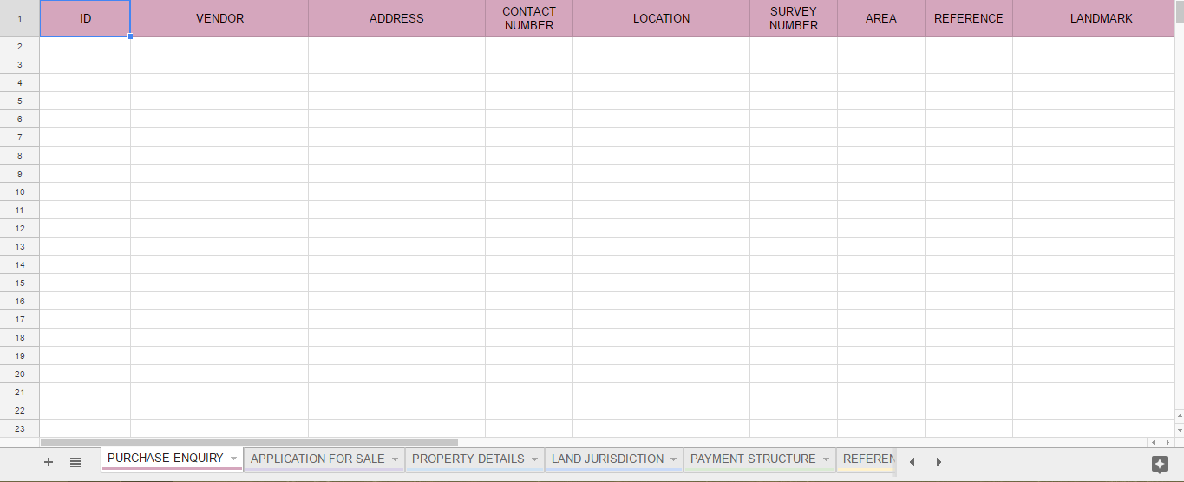
Documents

Slide 26
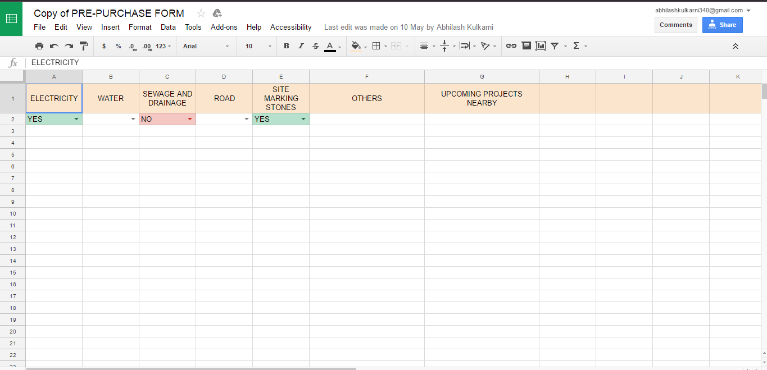
Documents

Slide 27
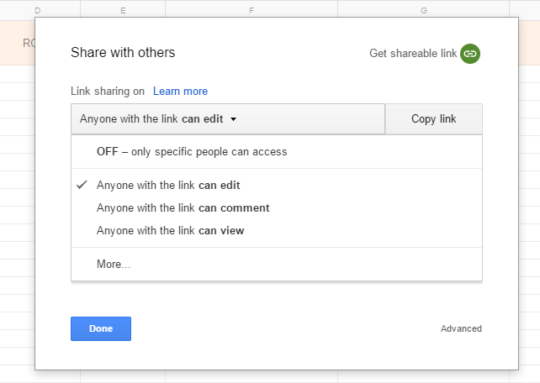
Documents
Google Sheets are used for security control

Slide 28
Mobile Application

Slide 29
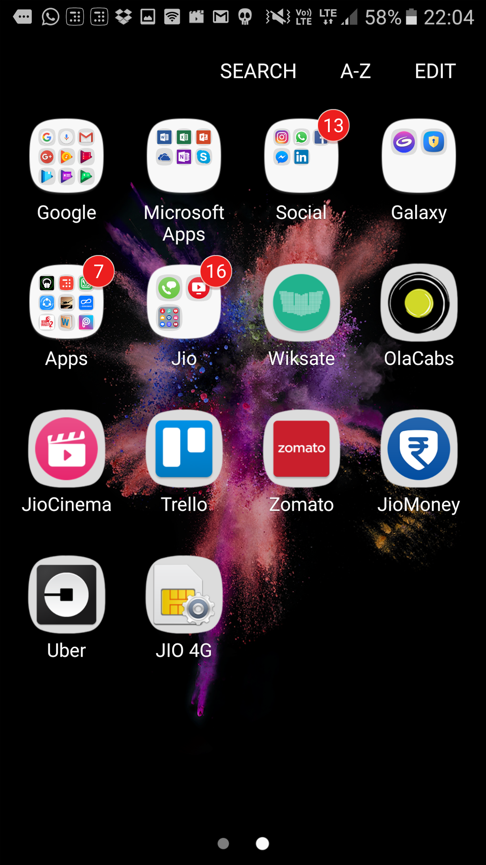
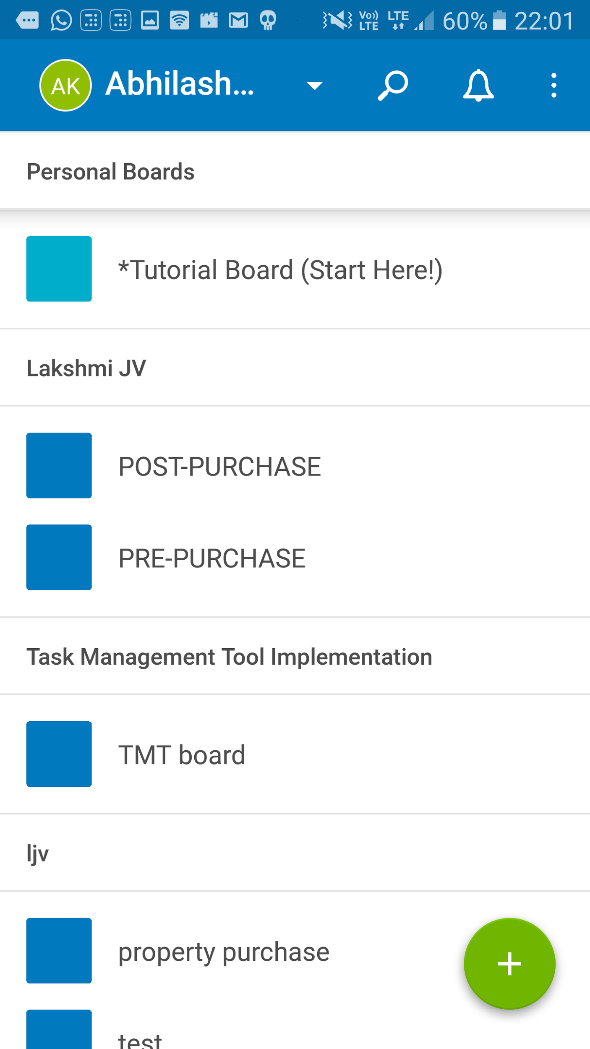
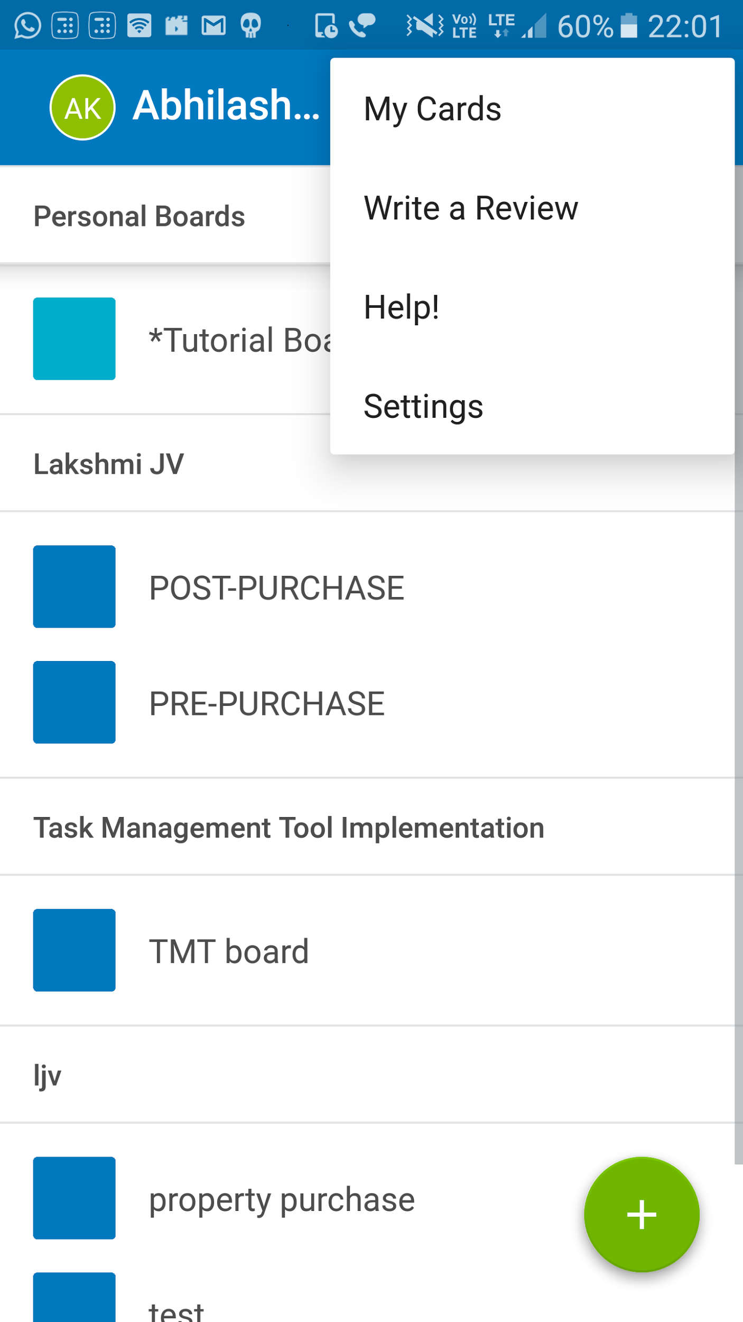
Mobile Application

Slide 30
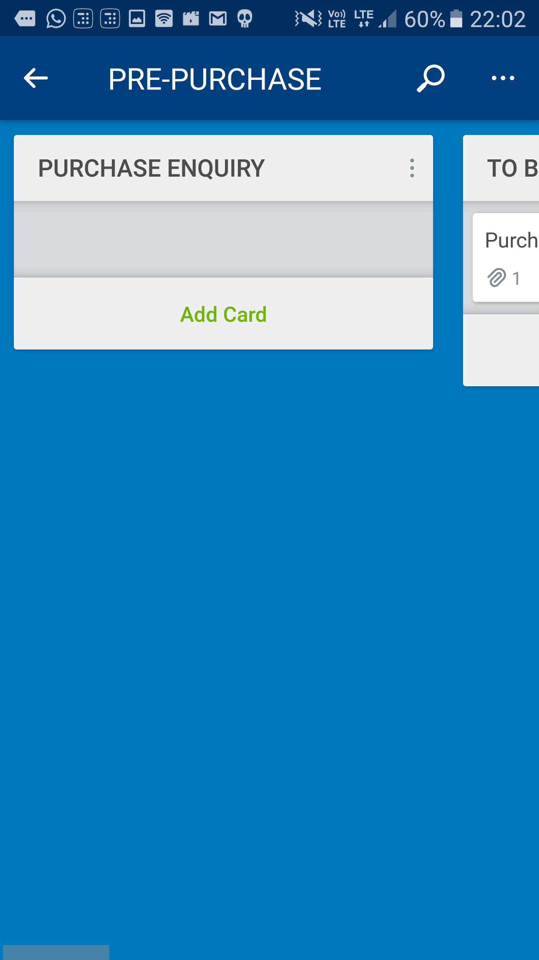
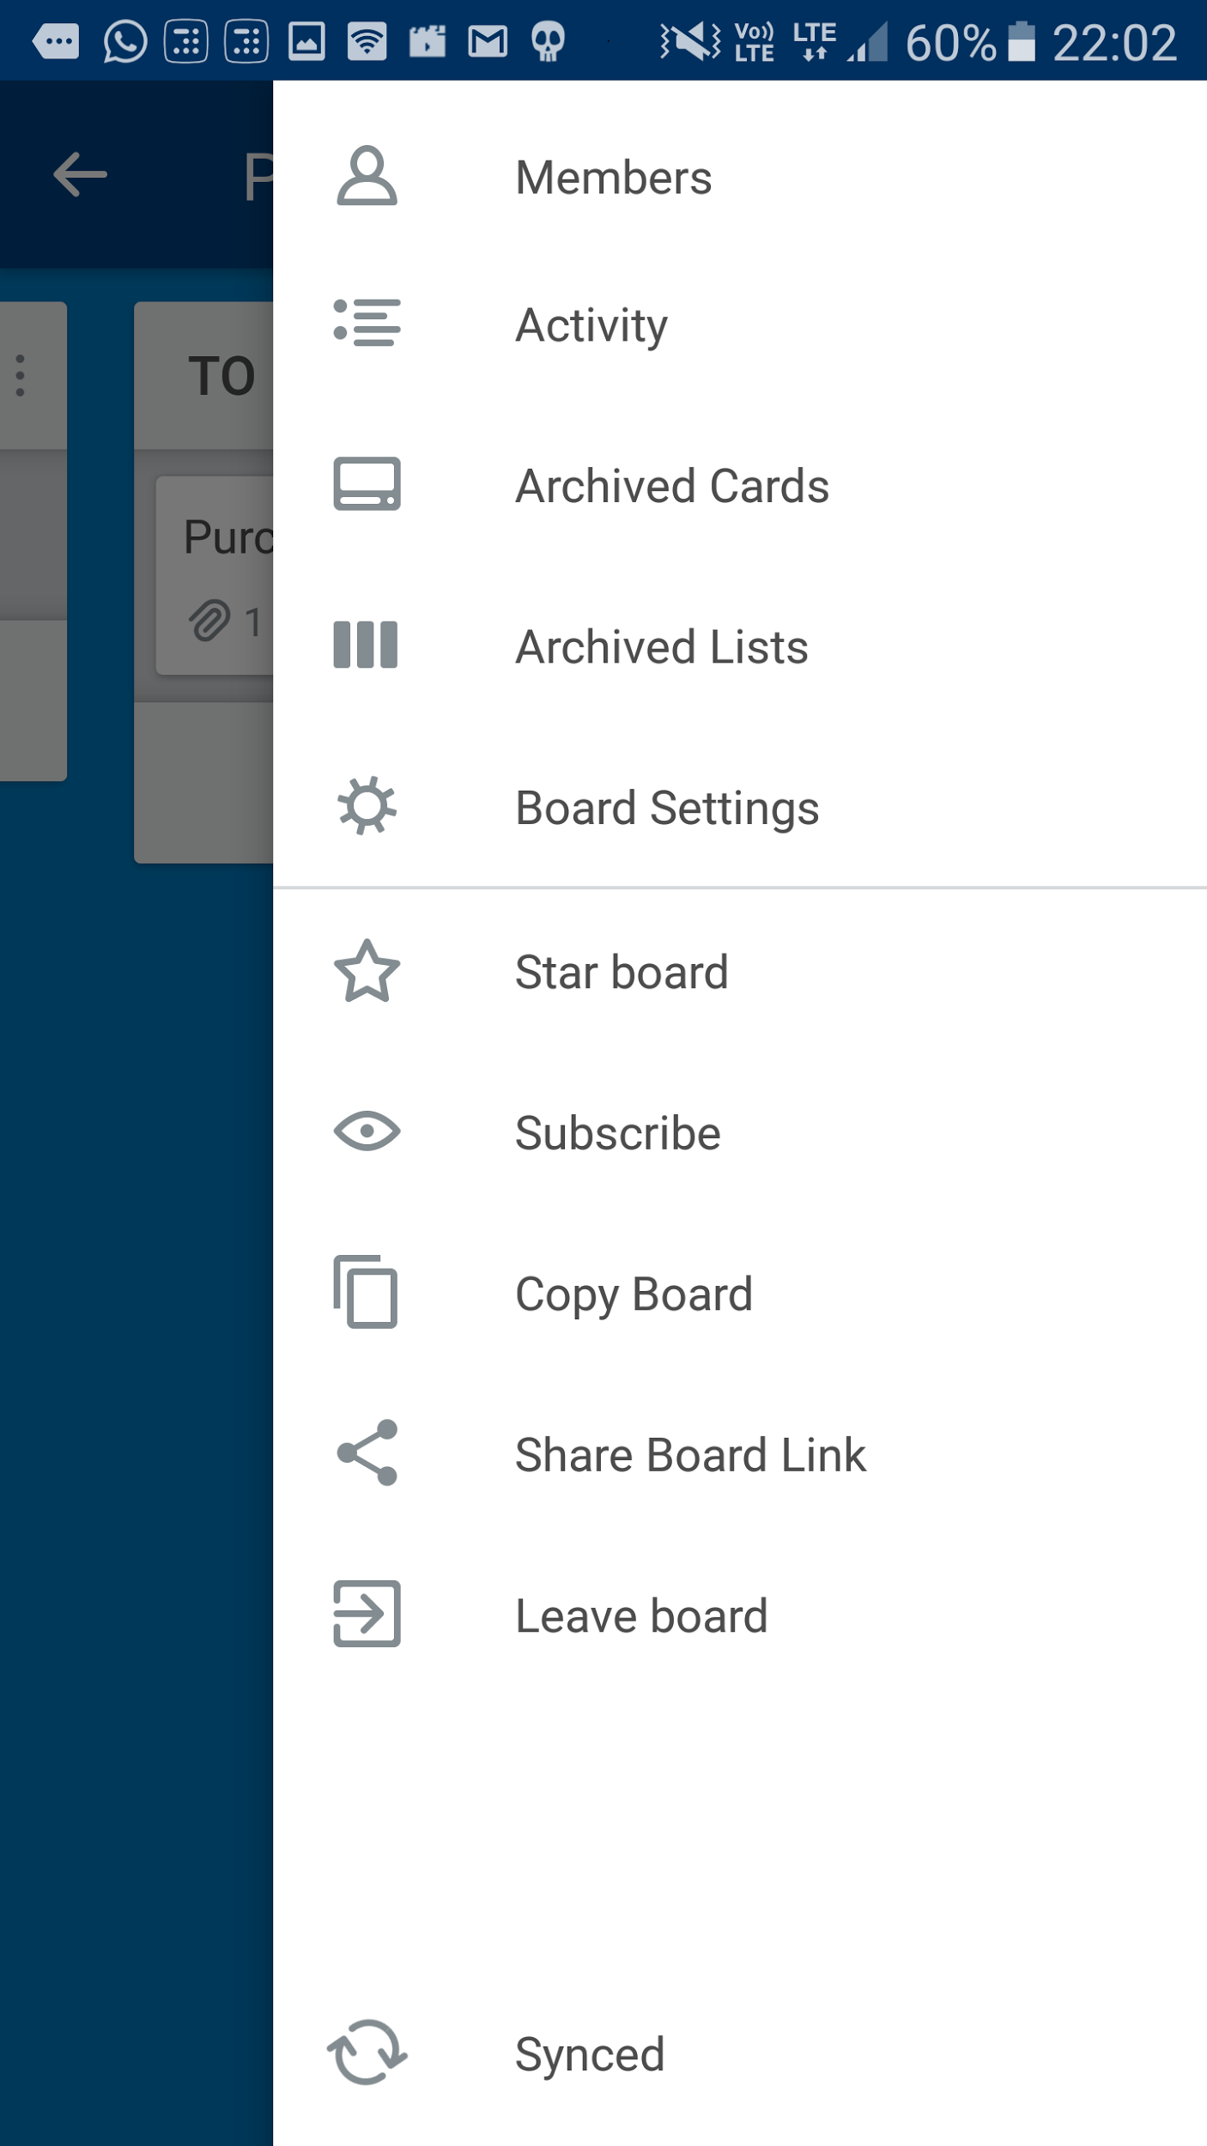
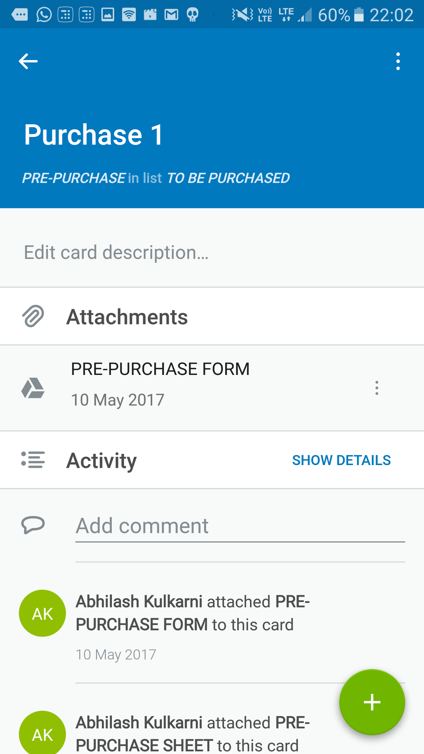
Mobile Application

Slide 31
Test Run

Slide 32
Test Run
Create an account
Install the mobile application
Create team and add members
Create board, list and card
Create a project and add its details
Attach a document, photo, etc
Move the cards

Slide 33
Test Run
Name : Patta transfer
Description : to transfer patta in the name of RV
Due-Date : 31 May 2017
Member
Checklist:
RV petition to be obtained
RV statement to be obtained
Revenue inspector statement

Slide 34
THANK YOU

